Slide 1


Python Booleans
Notes:
Hello and welcome to this Practicum AI recording.
I’m Dan Maxwell. And I work as an AI Trainer for Research Computing, here at the university of Florida.
In this short briefing, I’m going to introduce you to Python booleans.
[NEXT SLIDE]

Slide 2

Agenda
Booleans
Conditionals
Notes:
[NEXT SLIDE]

Slide 3
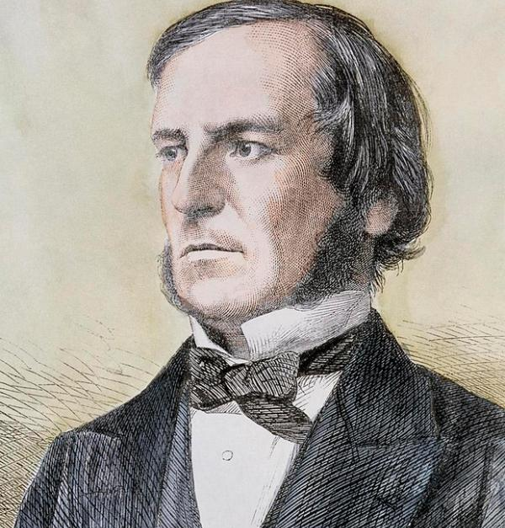
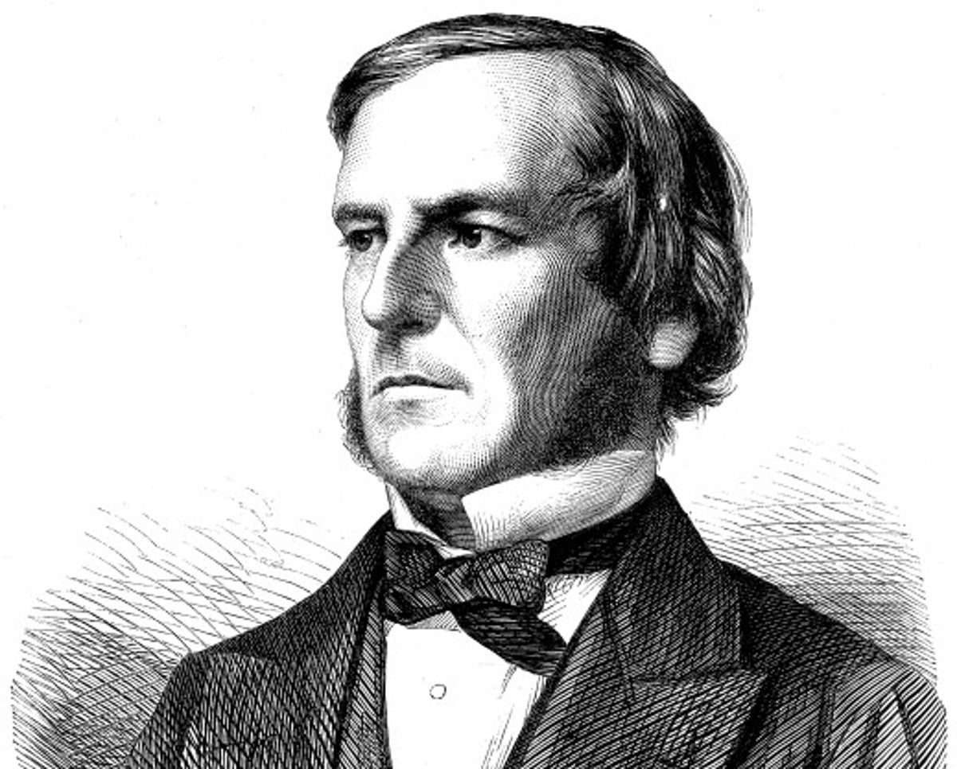
George Boole
George Boole, Public domain, via Wikimedia Commons
Image Credit: https://www.independent.co.uk/news/science/five-things-you-didn-t-know-about-george-boole-a6717401.html
Notes:
George Boole and Boolean logic
[NEXT SLIDE]

Slide 4
Boolean Operators
< less than
<= less than or equal to
> greater than
>= greater than or equal to
== equivalent to
!= not equivalent to
Notes:
[NEXT SLIDE]

Slide 5
Boolean Values – When is something true?
What are the following values?
int(True)
int(False)
float(True)
float(False)
str(True)
str(False)
What about these values?
bool(2)
bool(0)
All non-zero integers are True!
bool(2.1)
bool(0.0)
All non-zero floating point values are True!
bool('hello')
bool('')
All non-empty strings are True!
1
True
0
False
1.0
0.0
True
False
'True'
'False'
True
False
Notes:
[NEXT SLIDE]

Slide 6
Python Conditionals
Notes:
Hello and welcome to this Practicum AI recording.
I’m Dan Maxwell. And I work as an AI Trainer for Research Computing, here at the university of Florida.
In this short briefing, I’m going to introduce you to Python conditionals.
[NEXT SLIDE]

Slide 7

Conditionals can become complex
Photo by Nick Fewings on Unsplash
Notes:
[NEXT SLIDE]

Slide 8
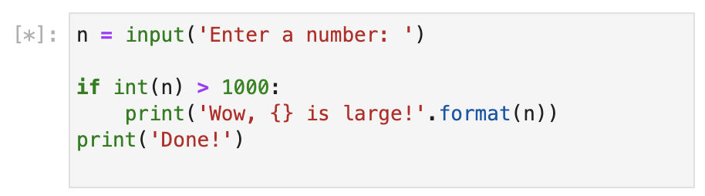
Python if statement
Simplest IF statement syntax
if <condition>:
<indent> <statement>
<indent> <statement>
< . . . statements>
<statement after if>
<condition> evaluates to True or False
i.e. Boolean
All indented statements are executed *if* <condition> is True
Otherwise, execution resumes after indention ends
Notes:
[NEXT SLIDE]

Slide 9
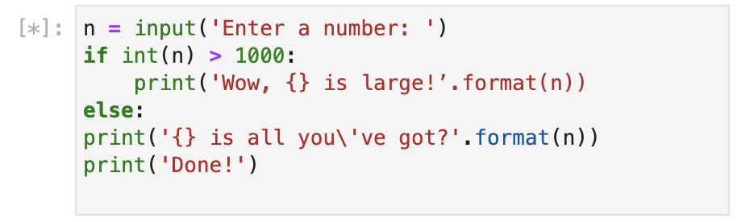
Python if else statement
If else statement syntax
if <condition>:
< statements>
else:
<statements>
<statements after if>
Indented <statements> after the else: are executed if <condition> is False
else has no <condition>!
[NEXT SLIDE]
Notes:
[NEXT SLIDE]

Slide 10
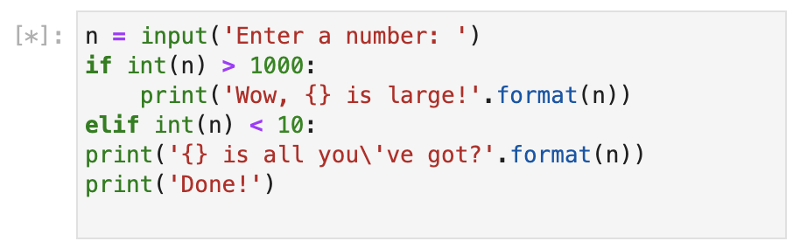
Python if elif (else if) statement
If elif statement syntax
if <condition1>:
< statements>
elif <condition2>:
<statements>
<statements after if>
Indented <statements> after the elif are executed if
<condition1> is False
AND
<condition2> is True
Multiple elif blocks are allowed, but only one else
Notes:
[NEXT SLIDE]

Slide 11
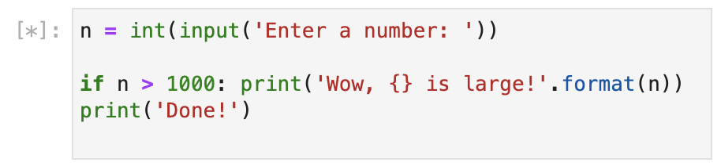
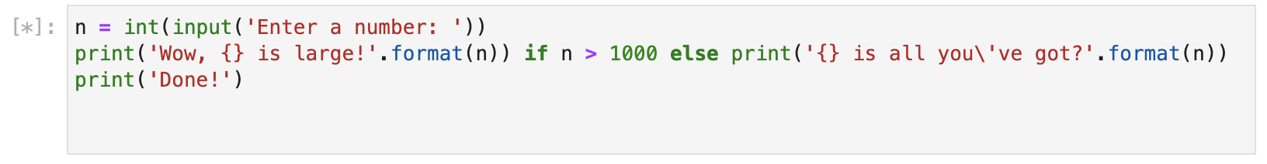
Shorthand If statements
Shorthand if statement
Single executed statement only
if <condition>: <statement>
Shorthand if else statement
<statement> if <condition> else <statement>
Notes:
[NEXT SLIDE]

